Slide 1
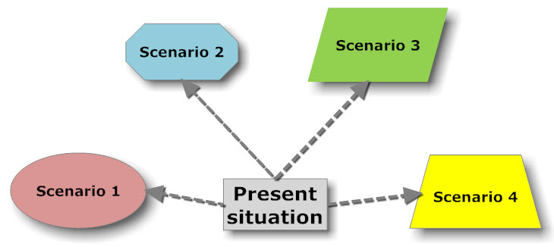
OC 6440
Organizational Change and Development
Week 5
Scenario Planning

Slide 2
Scenarios - Definitions
Scenarios are structurally different stories about how the future might develop
Scenario 1
Scenario 2
Scenario 3
Scenario 4
Today
Single-point forecast
The future

Slide 3
Scenarios - Benefits (I)
New ways of thinking about and planning for the future
    Removal of blinders
    Exploration of new ideas and business opportunities
A test bed for evaluation of business goals and strategies
    Identification of optimal and robust goals and strategies
“A map of the future”
    A common mental framework for discussing future issues
    Faster response to a changing business environment

Slide 4
Scenarios - Benefits (II)
”Scenarios aim to strech thinking about the future
and widen the range of alternatives considered”
Michael Porter:
Competitive Advantage, 1985
”To create the future, a company must first be
capable of imagining it”
Gary Hamel and C.K. Prahalad:
Competing for the Future, 1994
”Scenarios are the most powerful vehicles I know
for challenging our ”mental models” about the world,
and lifting the blinders that limit our creativity
and resourcefulness”
Peter Schwartz:
The Art of the Long View, 1991

Slide 5
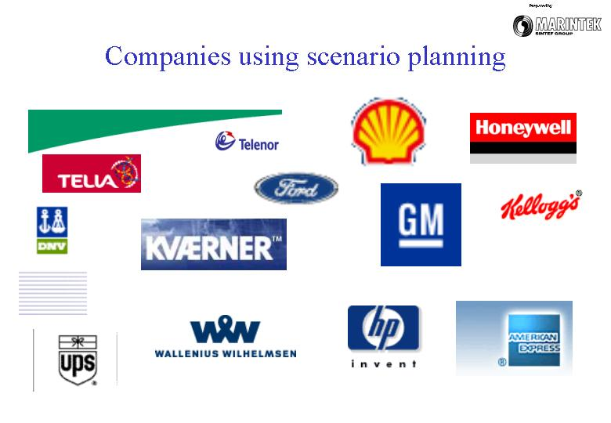
Companies using Scenarios today
Widely used in the strategy process
Also national scenario programmes - UK Foresight, Destino Colombia etc.

Slide 6
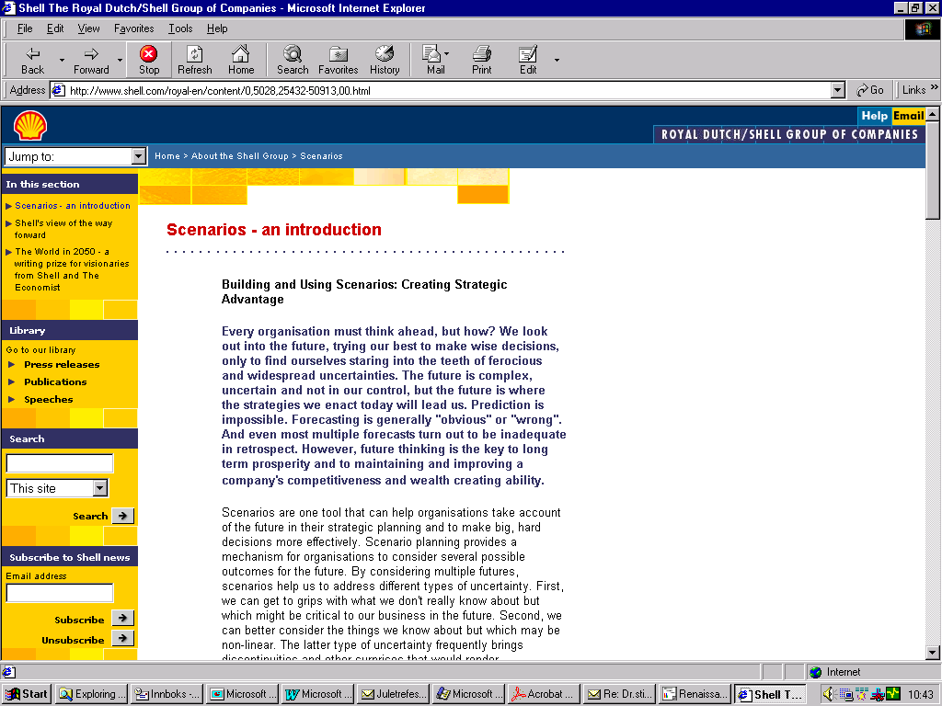
Companies using Scenarios:
Royal Dutch Shell
Have a look at shell.com
Used scenarios since early 70s
”Building scenarios is about widening perspectives. Using scenarios is about widening options”
Ged Davis, Shell
Notes:
Shell possesses the longest corporate history of scenario planning and is, perhaps, the most well-known practicioner.’
Listen to what Shell says about their approach to linking scenarios and strategy:
‘Current scenario planning at Shell is not subject to a mechanistic link to planning processes; rather, a combination of global scenarios and more focused local scenarios, with tools for facilitating scenario use, provide a broad framework that influences strategy development.’

Slide 7
Scenario Planning:
An Alternative Way
of Dealing
with Uncertainty

Slide 8
‘In times of rapid change, strategic failure is
often caused by a crisis of perception (that
is, the inability to see an emergent novel
reality by being locked inside obsolete
assumptions), particularly in large, well-run
companies’
Pierre Wack

Slide 9
‘I mistrust isolated trends ... In a period of rapid change, strategic planning based on straight-line trend extrapolation is inherently treacherous ... what is needed for planning is … multidimensional models that interrelate forces – technological, social, political, even cultural, along with the economies.’
Alvin Toffler in The Adaptive Corporation (1985)

Slide 10
Assumptions of scenario planning
Managers are not able to make valid
assessments of probabilities of unique
future events
2. Best guesses of the future may be wrong
3. Minority opinions should be allowed
‘airtime’

Slide 11
What are scenarios?
A scenario is not a forecast of the future
– multiple scenarios are pen pictures
encompassing a range of plausible futures
Each scenario has an infinitesimal
probability of occurrence, but the range
of the set of scenarios is constructed to
BOUND uncertainties seen to be inherent in
the future
Unlike probability judgments, scenarios
highlight the reasoning underlying judgments
about the future

Slide 12
More on scenarios
A major focus is how the future can evolve from now to the horizon year
Relationship between critical uncertainties,
predetermined trends and behavior of actors is thought through
Decisions are then tested for robustness in
the ‘wind tunnel’ of the set of scenarios

Slide 13
Scenario construction: The extreme world method
Identify the issue of concern and horizon year
Identify current trends that have an impact on the issue of concern
Identify critical uncertainties
Identify whether trends and uncertainties have a negative or positive impact on issue of concern
Create extreme worlds
Add predetermined trends to both scenarios
Check for internal consistency
Add in actions of individuals and organizations

Slide 14
Examples of predetermined trends
Demographic: population growth, birth rates
Technology: growth rates, production capacity
Political: power shifts, budget deficits
Cultural: changing values, spending
patterns
Economic: disposable incomes, investment
levels

Slide 15
When should a company use scenario planning?
When uncertainty is high
Too many costly surprises have occurred in the past
Insufficient new opportunities are perceived or generated
The industry has experienced significant change, or is about to
Strong differences of opinion exist, each of which has its merits

Slide 16
Typical outcomes of scenario planning
‘This is what we have to do’
(developing new business opportunities)
‘We better think again’
(understanding outcomes of plans better)
‘We better watch those dots on the horizon’
(perceiving weak signals of new developments)
‘We are in the right track’
(moving forward with more confidence)

Slide 17
Scenario Planning:
Another Look

Slide 18
Definition
Common definitions of the term “scenario”:
  An outline of the plot of the dramatic work giving particulars of the scenes, characters, etc.
  The outline or sometimes the complete script of a motion picture or a shooting script
  An imagined sequence of events, especially any of several detailed plans and possibilities

Slide 19
Definition
Scenarios in the context of Foresight
  Wack (1984):
  “a discipline for rediscovering the original entrepreneurial power of creative foresight in contexts of accelerated change, greater complexity and genuine uncertainty”
  Schwartz (1991):
  ‘‘tools for ordering one’s perceptions about alternative future environments in which one’s decisions might be played out’’
  Gausemeier et al. (1998):
  “a generally intelligible description of a possible situation in the future, based on complex network of influence factors”

Slide 20
Historical background
The concept first emerged following World War II, as a method for military planning. The U.S. Air Force tried to imagine what its opponents might do, and to prepare alternative strategies
In the 1960s, Herman Kahn, who had been part of the Air Force effort, refined scenarios as a tool for business prognostication
Scenarios reached a new dimension in the early 1970s with Pierre Wack’s work in Shell, which enabled the company to anticipate the rise and subsequent fall of oil prices in 1973

Slide 21
Key assumptions in using scenarios
The future not only is a continuum of past relationships and dynamics but also can be shaped by human choice and action
The future cannot be foreseen completely, but extrapolation of the future can inform the decisions of the present
There is not one possible future only. Uncertainty calls for a variety of futures mapping a ‘possibility space’
Development of scenarios involves both rational analysis and subjective judgement. It therefore requires interactive and participative methods

Slide 22
Dual meaning of scenarios
Image of the future: a state of affairs, describing the circumstances at a particular point in future time
Future history: a “story” of the evolution of affairs, in the form of a sequence of events or developments of trends
Now: where are we, what should we do...
histories
images

Slide 23
Essential characteristics of scenarios
Internally consistent
Link historical and present events with hypothetical events in the future
Carry storylines that can be expressed in simple diagrams
Plausible
Reflect predetermined elements
Identify signposts or indicators that a given story is occurring
(van der Heijden, 1997)

Slide 24
A successful scenario
Describes the possible future changes in a particular ‘system’, domain, environment, society, etc.
Involves the imagination
Are written in the past or present tense - as if the visualized trends & events had already happened
Indicates the causes and consequences of key developments
Challenges our current images & conjectures about the future
Helps us to create and evaluate alternative policies, strategies and actions
Is seen as relevant and an important element of the strategic decision/policy making process

Slide 25
Variations: Single vs. Multiple
Single Scenario
  To illustrate and communicate features of forecasts and future-relevant analyses
  To provide a framework in terms of which views of different aspects of future developments can be integrated and their consistency or otherwise examined
  To structure and guide discussion so that visions, elements of visions, and the assumptions that underpin such visions, can be explicated and elaborated.
  To set a target (e.g. for aspirational purposes)

Slide 26
Single vs. Multiple
Multiple Scenarios
  To illustrate alternatives, indicate a range of plausible developments (not one inevitable future path); to assess robustness of strategies; to stimulate reflection on underlying assumptions
  To give insight into contexts and outcomes (intended or otherwise) of actions, & conditions when objectives may be realised; to help identify turning points, key decisions, indicators, early warnings of change
  Common to use 3 or more scenarios

Slide 27
Normative vs. Exploratory
Normative scenarios
  Starts with preliminary view of a possible future and look backwards to see if and how this might or might not grow out from the present
Explorative scenarios
  Starts with the present as starting points and move forward to the future by asking ‘what if’ questions about implications of possible events outside familiar trends
  Use data about the past and present bearing in mind the possible, probable and desirable

Slide 28
Inward vs. Outward
Starting from the present (“exploratory”):
What next?
What if?
OUTWARD
INWARD
Starting from the future (“normative”):
Where to?
How to?

Slide 29
Outward Scenarios - Example
Trends and events of particular interest to users - not necessarily preferable ones
A common framework for workshop and expert groups is STEEPV:
Social
Technological
Economic
Environmental
Political
Values
Events/Trends
Worldviews

Slide 30
Inward Scenarios - Example
Futures of particular interest to users - not necessarily desirable ones : a PROFILE approach
Will world economic development mean:
What would
it be like?
How do we
get there?
High Growth
Profile 1
Profile 2
High Equality
Low Equality
Profile 3
Profile 4
Worldviews
Low Growth

Slide 31
Methods for scenario planning
Forecasts
Deskwork
Expert Groups
“Modeling” tools like simulation, cross-impact; gaming
Surveys, clustering articulated viewpoints
Workshops

Slide 32
Scenario workshops
A scenario workshop allows the participants to:
  exchange information, views and insights,
  identify points of agreement, disagreement and uncertainty
  create new shared understandings
  develop action plans and other instruments so as to help mobilise future activity

Slide 33
A model for the organisation of a scenario workshop
Step 1: Set up a preliminary objective including the time horizon
Step 2: Establish a broad learning programme under the STEEPV guidelines to enable the boundaries appropriate to the objective to be derived and the broad trends that influence the objective to be identified; and by asking ‘who and what’ is important to the objective, map out more specifically the driving forces for your organisation in creating its future
Step 3: Make explicit the assumptions that will be used in writing the scenarios; examine these assumptions for their relevance, reasonableness and robustness in relation to the assumed objective; and, through iteration, modify both until a convergence is achieved
Step 4: Assemble a framework of alternative event strings and trends that are the skeletons for the scenarios
Step 5: Write the scenarios using whatever presentational technique seems to be most suited to the objective and the organisation’s culture
Step 6: Analyse the scenarios with particular reference to turning or branch points that may constitute a crisis
Step 7: Derive from the analysis, the policies within which the organisation ought to work (the limits of actions the organisation ought not to exceed in seeking to achieve its objective), the instruments of policy over which the organisation has control and those that are beyond its control
Step 8: Using the instruments of policy, derive alternative strategies
Step 9: Evaluate these strategic alternatives over the chosen timescale, paying particular attention to the strategic allocation of resources, including financing, and the best routes to achieving the desired financial returns

Slide 34
Product & process benefits of scenario planning
Product (codified outputs) - reports, books, videos. Discursive accounts, summaries, action lists and priorities. Inputs to decision making.
  Scenarios: integrate diverse studies, concretise and communicate visions; suggest action points and key indicators
Process (embodied knowledge) - forging and enriching networks, developing knowledge about knowledge. Establishing and empowering constituencies for action.
  Scenarios: recruit support, integrate diverse viewpoints; share & fuse visions, provide focus for joint work.

Slide 35
Develop strategy alternatives
Scenario D
What if we knew
Scenario C
this scenario
would occur?
Scenario B
Scenario A
What would be the threats and
opportunities?
•
•
•
What strategy and actions
would we implement?
•
•
•
What do we monitor for this
scenario?
•
•
•
SOURCE: SRIC

Slide 36
How to get it wrong (Coates)
Mechanical Extrapolation
  limits, ceilings, qualitative change
Unexamined assumptions
Limited Expertise
  failure to see limits, connections
Limited Vision
  failure to see outsiders, novelty, significant events

Slide 37
Integrating scenarios with other methods
Scenarios can be used with other methods such as
  Expert panels
  STEEPV analysis
  SWOT analysis
  Some research on the area of interest
  Road mapping and/or
  Delphi

Slide 38
Summary
Future is uncertain and thus there is multiplicity
Scenarios are helpful
  to create multiple images of the future, thus
  to be ready for the alternative courses of future developments
Scenarios elicit and represent knowledge of participants in an interactive and coherent way
Scenarios are widely used in Foresight exercises, not only for the product benefits, but also for the process benefits

Slide 39
The process of scenario planning
This diagram shows our basic process for scenario planning. We work within this framework to tailor solutions to suit our clients’ needs
Set objectives
Identify
key issues
Build
scenarios
Create
options
Refine
options
Maintain learning

Slide 40
Set objectives
Setting the objectives is the essential starting point for scenario planning, in order to define boundaries and establish focus
A client-side strategy manager should be appointed at this earliest stage of the process. This manager will provide the point of communication between Analysys Mason and the stakeholders
The objectives for the scenario planning project must be clearly stated and agreed with the key stakeholders. They should include the following:
  time horizon for the scenarios
  geographical scope of the scenarios
  business units or product areas to be addressed by the project
  unavoidable constraints on future plans
  definition and deadline for deliverables

Slide 41
Identify key issues
The main threats and opportunities facing the company need to be explored in preparation for the scenario-building activities
This is best achieved through interviews with the key stakeholders, either individually or in small groups. These interviews provide an opportunity to:
  secure the stakeholders’ acceptance of the scenario-planning process
  gain the stakeholders’ trust
  listen to their views and concerns
  locate important sources of information for later analysis
  choose participants for workshops
The interviews follow a simple process:
  prepare an interview script containing a provocative survey of markets, technologies, competitors, etc, expressed in terms of dilemmas and choices
  use this script to gently guide interviews with the stakeholders
  collate the information and analyse the results to identify the key issues
  feed the analysis back to the stakeholders for review and agreement

Slide 42
Build scenarios [1]
Brainstorm the drivers of change, in workshops held with stakeholders. These drivers may include:
  business factors
  technology factors
  socio-economic factors
Agree upon the impact and likelihood of each driver
Establish what is inevitable and, therefore, must occur in all scenarios
Inevitable
Significant
Impact
Insignificant
Uncertainty

Slide 43
Build scenarios [2]
Identify the critical uncertainties, and group them to understand how they may act together to split the future into different scenarios
Check:
  the inter-relationships between the drivers with simple causal networks
  that the scenarios are mutually exclusive and collectively exhaustive
  that each scenario constitutes a challenging view of the future
Develop engaging descriptions of the scenarios supported by research and analysis
Inevitable change
Uncertain change

Slide 44
Create options
The next step is to use the scenarios to brainstorm business solutions
Additional workshops are held to examine each scenario in turn and generate many possible business solutions
From these we derive one simple plan for each scenario. The set of plans for each scenario are then compared:
  the common elements form the core business plan
  those differentiated by scenario become options for the future
Establish core plan for all scenarios
Brainstorm solutions for each scenario
Outline simple plans for each scenario
Compile series of options

Slide 45
Refine options
The core plan is now established. This next stage refines the options and finalises the overall business plans
There is a choice of attitude to take towards the options:
  focused drive for one future?
  cautious experimentation?
  low-risk contingency planning?
The approach chosen will depend upon the balance between risk and reward that the stakeholders wish to maintain
The various business options are tested in the different scenarios to evaluate their performance. Tests can involve script-writing, war-gaming or mathematical modelling
The options are synthesised in one plan and the decision points defined, in order to achieve the business objectives
Check core plan in all scenarios
Establish parameters for each scenario
Synthesise and test complete plan
Check options in relevant scenarios
Refine decision points

Slide 46
Maintain learning
Scenario planning should not be a one-off exercise: the greatest benefit is gained by continually developing and applying the scenarios
Long-term, scenario planning will capture ongoing business learning as it evolves
In the short term, an effective early-warning system can be created by establishing processes such as:
  short-listing critical parameters
  summarising significant scenario events
  defining how to track critical parameters and significant scenario events
  agreeing management process for tracking
  maintaining a strict schedule of reviews
  allocating clear responsibilities for tracking
  establishing processes for rapidly assessing consequences of events
  keeping the stakeholders up-to-date with regular bulletins
  adjusting business plans to keep pace with change in the business environment
Adjust plans
Track critical factors
Review scenarios

Slide 47
What is the checklist for success?
Set a clear objective for the scenario-planning project in close consultation with the stakeholders in the business
Build a creative and diverse team integrating client personnel with Analysys Mason team members
Appoint a champion for scenario planning within the business, to lead the project with support from the Analysys Mason team
Gain the commitment of key stakeholders, including board-level sponsorship
Agree and follow a sound process, based on our experience but tailored to the client needs

Slide 48
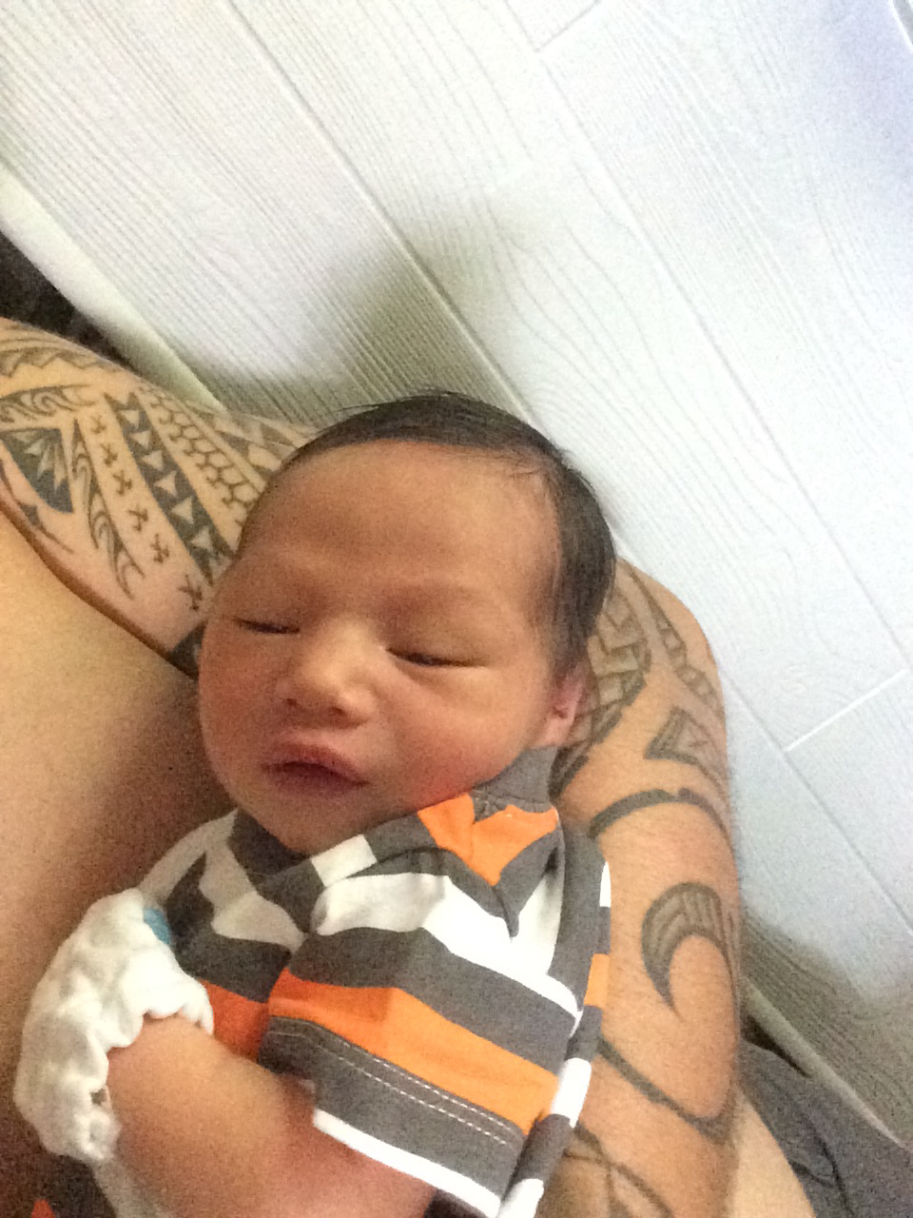
PAU!
(The Future)

Slide 49
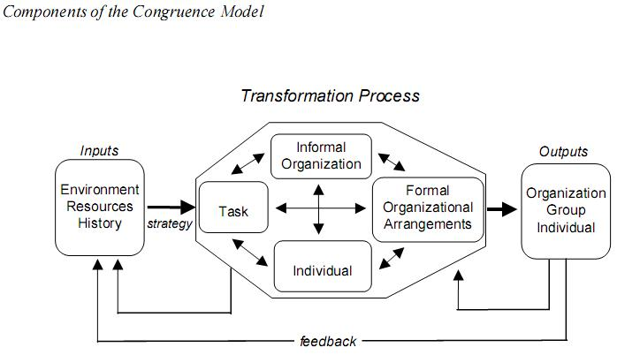

Slide 50
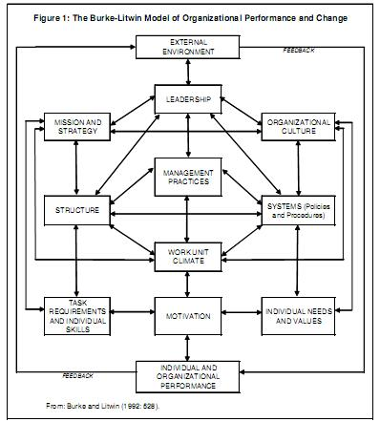

Slide 51
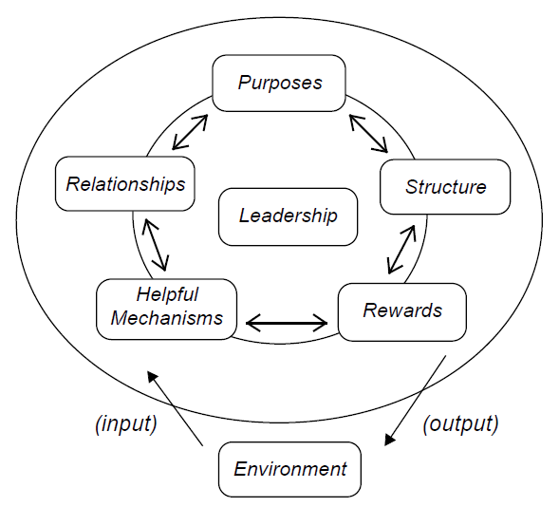

Slide 52
